Slide 1



Methodology of Problem Solving
Efficiently Solving Computer Programming Problems
Nikolay Kostov
Senior Software Developer and Technical Trainer
http://Nikolay.IT
Telerik Software Academy
academy.telerik.com

Slide 2
Table of Contents
Problem solving
Read and Analyze the Problems
Use a sheet of paper and a pen for sketching
Think up, invent and try ideas
Break the problem into subproblems
Check up your ideas
Choose appropriate data structures

Slide 3

Table of Contents (2)
Think about the efficiency
Implement your algorithm step-by-step
Thoroughly test your solution
How to search in Google

Slide 4



Problems Solving
From Chaotic to Methodological Approach

Slide 5

Understanding the Requirements

Slide 6
Read and Analyze the Problems
Consider you are at traditional computer programming exam or contest
You have 5 problems to solve in 8 hours
First read carefully all problems and try to estimate how complex each of them is
Read the requirements, don't invent them!
Start solving the most easy problem first!
Leave the most complex problem last!
Approach the next problem when the previous is completely solved and well tested

Slide 7
Analyzing the Problems
Example: we are given 3 problems:
Shuffle-cards
Shuffle a deck of cards in random order
Students
Read a set of students and their marks and print top 10 students with the best results (by averaging their marks)
Sorting numbers
Sort a set of numbers in increasing order

Slide 8
Analyzing the Problems (2)
Read carefully the problems and think a bit about their possible solutions
Order the problems from the easiest to the most complex:
Sorting numbers
Trivial – we can use the built-in sorting in .NET
Shuffle-cards
Need to randomize the elements of array
Students
Needs summing, sorting and text file processing

Slide 9

Using a Paper and a Pen
Visualizing and Sketching your Ideas

Slide 10

Use a Sheet of Paper and a Pen
Never start solving a problem without a sheet of paper and a pen
You need to sketch your ideas
Paper and pen is the best visualization tool
Allows your brain to think efficiently
Paper works faster than keyboard / screen
Other visualization tool could also work well

Slide 11
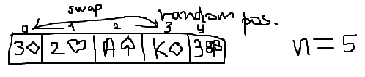
Paper and Pen
Consider the "cards shuffle" problem
We can sketch it to start thinking
Some ideas immediately come, e.g.
Split the deck into two parts and swap them a multiple times
Swap 2 random cards a random number of times
Swap each card with a random card

Slide 12

Invent Ideas
Think-up, Invent Ideas and Check Them

Slide 13
Think up, Invent and Try Ideas
First take an example of the problem
Sketch it on the sheet of paper
Next try to invent some idea that works for your example
Check if your idea will work for other examples
Try to find a case that breaks your idea
Try challenging examples and unusual cases
If you find your idea incorrect, try to fix it or just invent a new idea

Slide 14
Invent and Try Ideas – Example
Consider the "cards shuffle" problem
Idea #1: random number of times split the deck into left and right part and swap them
How to represent the cards?
How to chose a random split point?
How to perform the exchange?
Idea #2: swap each card with a random card
How many times to repeat this?
Is this fast enough?

Slide 15
Invent and Try Ideas – Example (2)
Idea #3: swap 2 random cards a random number of times
How to choose two random cards?
How many times repeat this?
Idea #4: choose a random card and insert it in front of the deck
How to choose random card?
How many times repeat this?

Slide 16
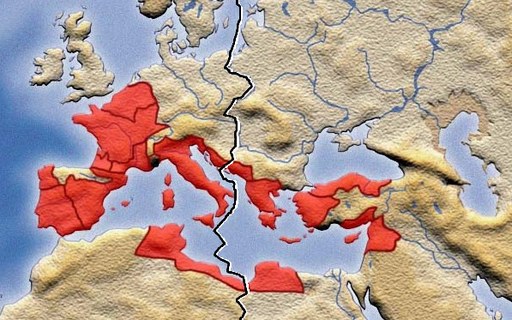
Divide and Conquer
Decompose Problems into Manageable Pieces

Slide 17
Decompose the Problem into Subproblems
Work decomposition is natural in engineering
It happens every day in the industry
Projects are decomposed into subprojects
Complex problems could be decomposed into several smaller subproblems
Technique known as "Divide and Conquer"
Small problems could easily be solved
Smaller subproblems could be further decomposed as well

Slide 18
Divide and Conquer – Example
Let's try idea #1:
Multiple times split the deck into left and right part and swap them
Divide and conquer
Subproblem #1 (single exchange) – split the deck into two random parts and exchange them
Subproblem #2 – choosing a random split point
Subproblem #3 – combining single exchanges
How many times to perform "single exchange"?

Slide 19
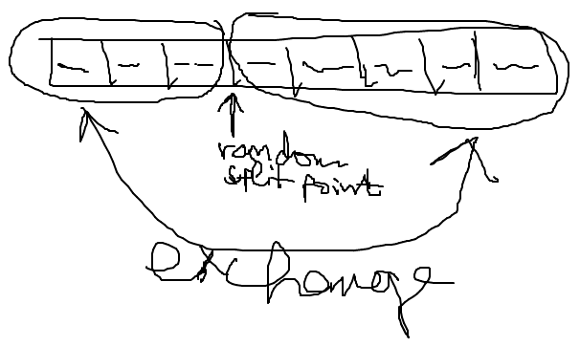
Subproblem #1 (Single Exchange)
Split the deck into 2 parts at random split point and exchange these 2 parts
We visualize this by paper and pen:

Slide 20
Subproblem #2 (Random Split Point)
Choosing a random split point
Needs to understand the concept of pseudo-random numbers and how to use it
In Internet lots of examples are available, some of them incorrect
The class System.Random can do the job
Important detail is that the Random class should be instantiated only once
Not at each random number generation

Slide 21
Subproblem #3 (Combining Single Exchanges)
Combining a sequence of single exchanges to solve the initial problem
How many times to perform single exchanges to reliably randomize the deck?
N times (where N is the number of the cards) seems enough
We have an algorithm:
N times split at random position and exchange the left and right parts of the deck

Slide 22

Check-up Your Ideas
Don't go Ahead before Checking Your Ideas

Slide 23
Check-up Your Ideas
Check-up your ideas with examples
It is better to find a problem before the idea is implemented
When the code is written, changing radically your ideas costs a lot of time and effort
Carefully select examples for check-up
Examples should be simple enough to be checked by hand in a minute
Examples should be complex enough to cover the most general case, not just an isolated case

Slide 24
Check-up Your Ideas – Example
Let's check the idea:
After 3 random splits and swaps we obtain the start position → seems like a bug!

Slide 25
Invent New Idea If Needed
What to do when you find your idea is not working in all cases?
Try to fix your idea
Sometime a small change could fix the problem
Invent new idea and carefully check it
Iterate
It is usual that your first idea is not the best
Invent ideas, check them, try various cases, find problems, fix them, invent better idea, etc.

Slide 26
Invent New Ideas – Example
Invent few new ideas:
New idea #1 – multiple times select 2 random cards and exchange them
New idea #2 – multiple times select a random card and exchange it with the first card
New idea #3 – multiple times select a random card and move it to an external list
Let's check the new idea #2
Is it correct?

Slide 27
Check-up the New Idea – Example
The result seems correct

Slide 28

Think about Data Structures
Select Data Structures that Will Work Well

Slide 29
Choosing Appropriate Data Structures
Choose appropriate data structures before the start of coding
Think how to represent input data
Think how to represent intermediate program state
Think how to represent the requested output
You could find that your idea cannot be implemented efficiently
Or implementation will be very complex or inefficient

Slide 30
Choose Appropriate Data Structures – Example
How to represent a single card?
The best idea is to create a structure Card
Face – could be string, int or enumeration
Suit – enumeration
How to represent a deck of cards?
Array – Card[]
Indexed list – List<Card>
Set / Dictionary / Queue / Stack – not a fit

Slide 31

Efficiency and Performance
Is Your Algorithm Fast Enough?

Slide 32
Think About the Efficiency
Think about efficiency before writing the first line of code
Estimate the running time (asymptotic complexity)
Check the requirements
Will your algorithm be fast enough to conform with them
You don't want to implement your algorithm and find that it is slow when testing
You will lose your time

Slide 33
Efficiency is not Always Required
Best solution is sometimes just not needed
Read carefully your problem statement
Sometimes ugly solution could work for your requirements and it will cost you less time
Example: if you need to sort n numbers, any algorithm will work when n ∈ [0..500]
Implement complex algorithms only when the problem really needs them

Slide 34
Efficiency – Example
How much cards we have?
In a typical deck we have 52 cards
No matter how fast the algorithm is – it will work fast enough
If we have N cards, we perform N swaps → the expected running time is O(N)
O(N) will work fast for millions of cards
Conclusion: the efficiency is not an issue in this problem

Slide 35

Implementation
Coding and Testing Step-by-Step

Slide 36
Start Coding: Check List
Never start coding before you find correct idea that will meet the requirements
What you will write before you invent a correct idea to solve the problem?
Checklist to follow before start of coding:
Ensure you understand well the requirements
Ensure you have invented a good idea
Ensure your idea is correct
Ensure you know what data structures to use
Ensure the performance will be sufficient

Slide 37
Coding Check List – Example
Checklist before start of coding:
Ensure you understand well the requirements
Yes, shuffle given deck of cards
Ensure you have invented a correct idea
Yes, the idea seems correct and is tested
Ensure you know what data structures to use
Class Card, enumeration Suit and List<Card>
Ensure the performance will be sufficient
Linear running time → good performance

Slide 38
Implement your Algorithm Step-by-Step
"Step-by-step" approach is always better than "build all, then test"
Implement a piece of your program and test it
Then implement another piece of the program and test it
Finally put together all pieces and test it
Small increments (steps) reveal errors early
"Big bang" integration takes more time

Slide 39
Step #1 – Class Card
class Card
{
public string Face { get; set; }
public Suit Suit { get; set; }
public override string ToString()
{
string card =
"(" + this.Face + " " + this.Suit +")";
return card;
}
}
enum Suit
{
Club, Diamond, Heart, Spade
}

Slide 40
Step #1 – Test
Testing the class Card to get feedback as early as possible:
The result is as expected:
static void Main()
{
Card card = new Card() { Face="A", Suit=Suit.Club };
Console.WriteLine(card);
}
(A Club)

Slide 41
Step #2 – Create and Print a Deck of Cards
static void Main()
{
List<Card> cards = new List<Card>();
cards.Add(new Card() { Face = "7", Suit = Suit.Heart });
cards.Add(new Card() { Face = "A", Suit = Suit.Spade });
cards.Add(new Card() { Face = "10", Suit = Suit.Diamond });
cards.Add(new Card() { Face = "2", Suit = Suit.Club });
cards.Add(new Card() { Face = "6", Suit = Suit.Diamond });
cards.Add(new Card() { Face = "J", Suit = Suit.Club });
PrintCards(cards);
}
static void PrintCards(List<Card> cards)
{
foreach (Card card in cards)
{
Console.Write(card);
}
Console.WriteLine();
}

Slide 42
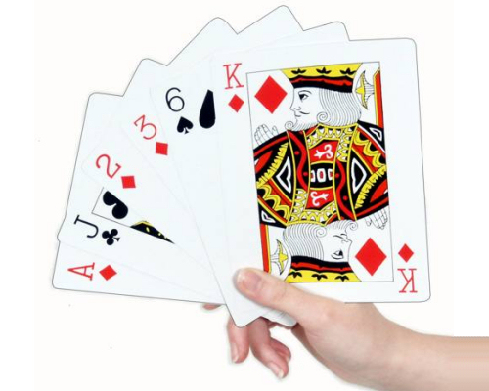
Step #2 – Test
Testing the deck of cards seems to be working correctly:
(7 Heart)(A Spade)(10 Diamond)(2 Club)(6 Diamond)(J Club)

Slide 43
Step #3 – Single Exchange
static void PerformSingleExchange(List<Card> cards)
{
Random rand = new Random();
int randomIndex = rand.Next(1, cards.Count - 1);
Card firstCard = cards[1];
Card randomCard = cards[randomIndex];
cards[1] = randomCard;
cards[randomIndex] = firstCard;
}

Slide 44
Step #3 – Test
To test the single exchange we use the following code:
The result is unexpected:
static void Main()
{
List<Card> cards = new List<Card>();
cards.Add(new Card() { Face = "2", Suit = Suit.Club });
cards.Add(new Card() { Face = "3", Suit = Suit.Heart });
cards.Add(new Card() { Face = "4", Suit = Suit.Spade });
PerformSingleExchange(cards);
PrintCards(cards);
}
(2 Club)(3 Heart)(4 Spade)

Slide 45
Step #3 – Fix Bug and Test
The first element of list is at index 0, not 1:
The result is again incorrect (3 times the same):
static void PerformSingleExchange(List<Card> cards)
{
Random rand = new Random();
int randomIndex = rand.Next(1, cards.Count - 1);
Card firstCard = cards[0];
Card randomCard = cards[randomIndex];
cards[0] = randomCard;
cards[randomIndex] = firstCard;
}
(3 Heart)(2 Club)(4 Spade)
(3 Heart)(2 Club)(4 Spade)
(3 Heart)(2 Club)(4 Spade)

Slide 46
Step #3 – Fix Again and Test
Random.Next() has exclusive end range:
The result now seems correct:
static void PerformSingleExchange(List<Card> cards)
{
Random rand = new Random();
int randomIndex = rand.Next(1, cards.Count);
Card firstCard = cards[0];
Card randomCard = cards[randomIndex];
cards[0] = randomCard;
cards[randomIndex] = firstCard;
}
(3 Heart)(2 Club)(4 Spade)
(4 Spade)(3 Heart)(2 Club)
(4 Spade)(3 Heart)(2 Club)

Slide 47
Step #4 – Shuffle the Deck
Shuffle the entire deck of cards:
The result is surprisingly incorrect:
static void ShuffleCards(List<Card> cards)
{
for (int i = 1; i <= cards.Count; i++)
{
PerformSingleExchange(cards);
}
}
Initial deck: (7 Heart)(A Spade)(10 Diamond)(2 Club)(6 Diamond)(J Club)
After shuffle: (7 Heart)(A Spade)(10 Diamond)(2 Club)(6 Diamond)(J Club)

Slide 48
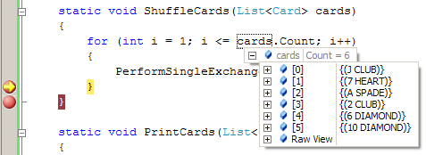
Step #4 – Strange Bug
When we step through the code with the debugger, the result seems correct:
Without the debugger the result is wrong!
Initial deck: (7 Heart)(A Spade)(10 Diamond)(2 Club)(6 Diamond)(J Club)
After shuffle: (10 Diamond)(7 Heart)(A Spade)(J Club)(2 Club)(6 Diamond)

Slide 49
Step #4 – Fix Again and Test
Random should be instantiated only once:
The result finally is correct with and without the debugger
private static Random rand = new Random();
static void PerformSingleExchange(List<Card> cards)
{
int randomIndex = rand.Next(1, cards.Count);
Card firstCard = cards[0];
Card randomCard = cards[randomIndex];
cards[0] = randomCard;
cards[randomIndex] = firstCard;
}

Slide 50

Testing
Thoroughly Test Your Solution

Slide 51
Thoroughly Test your Solution
Wise software engineers say that:
Inventing a good idea and implementing it is half of the solution
Testing is the second half of the solution
Always test thoroughly your solution
Invest in testing
One 90-100% solved problem is better than 2 or 3 partially solved
Testing existing problem takes less time than solving another problem from scratch

Slide 52
How to Test?
Testing could not certify absence of defects
It just reduces the defects rate
Well tested solutions are more likely to be correct
Start testing with a good representative of the general case
Not a small isolated case
Large and complex test, but
Small enough to be easily checkable

Slide 53
How to Test? (2)
Test the border cases
E.g. if n ∈ [0..500] → try n=0 , n=1, n=2, n=499, n=500
If a bug is found, repeat all tests after fixing it to avoid regressions
Run a load test
How to be sure that your algorithm is fast enough to meet the requirements?
Use copy-pasting to generate large test data

Slide 54
Read the Problem Statement
Read carefully the problem statement
Does your solution print exactly what is expected?
Does your output follow the requested format?
Did you remove your debug printouts?
Be sure to solve the requested problem, not the problem you think is requested!
Example: "Write a program to print the number of permutations on n elements" means to print a single number, not a set of permutations!

Slide 55
Testing – Example
Test with full deck of 52 cards
Serious error found → change the algorithm
Change the algorithm
Exchange the first card with a random card → exchange cards 0, 1, …, N-1 with a random card
Test whether the new algorithm works
Test with 1 card
Test with 2 cards
Test with 0 cards
Load test with 52 000 cards

Slide 56
Test with 52 Cards – Example
static void TestShuffle52Cards()
{
List<Card> cards = new List<Card>();
string[] allFaces = new string[] { "2", "3", "4", "5", "6", "7", "8", "9", "10", "J", "Q", "K", "A" };
Suit[] allSuits = new Suit[] { Suit.Club, Suit.Diamond,
Suit.Heart, Suit.Spade };
foreach (string face in allFaces)
{
foreach (Suit suit in allSuits)
{
Card card = new Card() { Face = face, Suit = suit };
cards.Add(card);
}
}
ShuffleCards(cards);
PrintCards(cards);
}

Slide 57
Test with 52 Cards – Example (2)
The result is surprising:
Half of the cards keep their initial positions
We have serious problem – the randomization algorithm is not reliable
(4 Diamond)(2 Diamond)(6 Heart)(2 Spade)(A Spade)(7 Spade)(3 Diamond)(3 Spade)(4 Spade)(4 Heart)(6 Club)(K Heart)(5 Club)(5 Diamond)(5 Heart)(A Heart)(9 Club)(10 Club)(A Club)(6 Spade)(7 Club)(7 Diamond)(3 Club)(9 Heart)(8 Club)(3 Heart)(9 Spade)(4 Club)(8 Heart)(9 Diamond)(5 Spade)(8 Diamond)(J Heart)(10 Diamond)(10 Heart)(10 Spade)(Q Heart)(2 Club)(J Club)(J Spade)(Q Club)(7 Heart)(2 Heart)(Q Spade)(K Club)(J Diamond)(6 Diamond)(K Spade)(8 Spade)(A Diamond)(Q Diamond)(K Diamond)

Slide 58
Fixing the Algorithm
New idea that slightly changes the algorithm:
Exchange the first card with a random card → exchange cards 0, 1, …, N-1 with a random card
static void PerformSingleExchange(List<Card> cards, int index)
{
int randomIndex = rand.Next(1, cards.Count);
Card firstCard = cards[index];
cards[index] = cards[randomIndex];
cards[randomIndex] = firstCard;
}
static void ShuffleCards(List<Card> cards)
{
for (int i = 0; i < cards.Count; i++)
{
PerformSingleExchange(cards, i);
}
}

Slide 59
Test with 52 Cards (Again)
The result now seems correct:
Cards are completely randomized
(9 Heart)(5 Club)(3 Club)(7 Spade)(6 Club)(5 Spade)(6 Heart) (4 Club)(10 Club)(3 Spade)(K Diamond)(10 Heart)(8 Club)(A Club)(J Diamond)(K Spade)(9 Spade)(7 Club)(10 Diamond)(9 Diamond)(8 Heart)(6 Diamond)(8 Spade)(5 Diamond)(4 Heart) (10 Spade)(J Club)(Q Spade)(9 Club)(J Heart)(K Club)(2 Heart) (7 Heart)(A Heart)(3 Diamond)(K Heart)(A Spade)(8 Diamond)(4 Spade)(3 Heart)(5 Heart)(Q Heart)(4 Diamond)(2 Spade)(A Diamond)(2 Diamond)(J Spade)(7 Diamond)(Q Diamond)(2 Club)
(6 Spade)(Q Club)

Slide 60
Test with 1 Card
Create a method to test with 1 card:
static void TestShuffleOneCard()
{
List<Card> cards = new List<Card>();
cards.Add(new Card() { Face = "A", Suit = Suit.Club });
CardsShuffle.ShuffleCards(cards);
CardsShuffle.PrintCards(cards);
}
We found a bug:
Unhandled Exception: System.ArgumentOutOfRangeException: Index was out of range. Must be non-negative and less than the size of the collection. Parameter name: index
…

Slide 61
Test with 1 Card – Bug Fixing
We take 1 card are special case:
static void ShuffleCards(List<Card> cards)
{
if (cards.Count > 1)
{
for (int i = 0; i < cards.Count; i++)
{
PerformSingleExchange(cards, i);
}
}
}
Test shows that the problem is fixed

Slide 62
Test with 2 Cards
Create a method to test with 2 cards:
static void TestShuffleTwoCards()
{
List<Card> cards = new List<Card>();
cards.Add(new Card() { Face = "A", Suit = Suit.Club });
cards.Add(new Card() { Face = "3", Suit = Suit.Diamond });
CardsShuffle.ShuffleCards(cards);
CardsShuffle.PrintCards(cards);
}
Bug: sequential executions get the same result:
(3 Diamond)(A Club)
The problem: the first and the second cards always exchange each other exactly once

Slide 63
Test with 2 Cards – Bug Fixing
We allow each card to be exchanged with any other random card, including itself
static void PerformSingleExchange(List<Card> cards, int index)
{
int randomIndex = rand.Next(0, cards.Count);
Card firstCard = cards[index];
Card randomCard = cards[randomIndex];
cards[index] = randomCard;
cards[randomIndex] = firstCard;
}
Test shows that the problem is fixed

Slide 64
Test with 0 Cards; Regression Tests
Testing with 0 cards (empty list) generates an empty list → correct result
Seems like the cards shuffle algorithm works correctly after the last few fixes
Needs a regression test
Test again that new changes did not break all previously working cases
Test with full deck of 52 cards; with 1 card; with 2 cards with 0 cards → everything works

Slide 65
Load Test – 52 000 Cards
Finally we need a load test with 52 000 cards:
static void TestShuffle52000Cards()
{
List<Card> cards = new List<Card>();
string[] allFaces = new string[] {"2", "3", "4", "5",
"6", "7", "8", "9", "10", "J", "Q", "K", "A"};
Suit[] allSuits = new Suit[] { Suit.Club, Suit.Diamond, Suit.Heart, Suit.Spade};
for (int i = 0; i < 1000; i++)
foreach (string face in allFaces)
foreach (Suit suit in allSuits)
cards.Add(new Card()
{ Face = face, Suit = suit });
ShuffleCards(cards);
PrintCards(cards);
}

Slide 66

How to Search in Google?
Some Advices for Successful Google Searching during Problem Solving

Slide 67
Search in Google Laws
Keep it simple
Most queries do not require advanced operators or unusual syntax → simple is good
Think what the page you are looking for is likely to contain → use the words that are most likely to appear on the page
A search engine is not a human, it is a program that matches the words you specify
For example, instead of saying "my head hurts", say "headache", because that's the term a medical page will use

Slide 68
Search in Google Laws (2)
Describe what you need with as less terms
Since all words are used, each additional word limits the results
If you limit too much, you will miss a lot of useful information
Choose descriptive words
The more unique the word is the more likely you are to get relevant results
Even if the word is correct, most people may use other word for the same concept

Slide 69
Search in Google Rules
Search is always case insensitive
Generally, punctuation is ignored, including @#$%^&*()=+[]\ and other special characters
Functional words like 'the', 'a', 'and', and 'for' are usually ignored
Synonyms might replace some words in your original query
A particular word might not appear on a page in your results if there is sufficient other evidence that the page is relevant

Slide 70
Search in Google Tips
Explicit phrase
Example: "path in a graph"
Exclude words
Example: path graph -tree
Site specific search
Search a specific website for content that matches a certain phrase
Example: graph site:msdn.microsoft.com

Slide 71
Search in Google Tips (2)
Similar words and synonyms
If you want to include a word in your search, but want to include results that contain similar words or synonyms
Example: "dijkstra" ~example
Specific Document Types
Example: "dijkstra" filetype:cs
This OR That
Example: "shortest path" graph OR tree

Slide 72


Search in Google Tips (3)
Numeric ranges
Example: "prime numbers" 50..100
Units converter
Example: 10 radians in degrees
Calculator
Example: 5 * 2^3

Slide 73
Search in Google Tips (4)
Fill in the blanks (*)
It tells Google to try to treat the star as a placeholder for any unknown term(s) and then find the best matches
Example: "* path in graph"
Results: shortest, longest, Hamiltonian, etc.
If you want to search C# code you can just add "using System;" to the search query
www.google.com/advanced_search

Slide 74
Summary
Problems solving needs methodology:
Understanding and analyzing problems
Using a sheet of paper and a pen for sketching
Thinking up, inventing and trying ideas
Decomposing problems into subproblems
Selecting appropriate data structures
Thinking about the efficiency and performance
Implementing step-by-step
Testing the nominal case, border cases and efficiency

Slide 75
Methodology of Problem Solving
http://academy.telerik.com

Slide 76




Free Trainings @ Telerik Academy
C# Programming @ Telerik Academy
csharpfundamentals.telerik.com
Telerik Software Academy
academy.telerik.com
Telerik Academy @ Facebook
facebook.com/TelerikAcademy
Telerik Software Academy Forums
forums.academy.telerik.com

